Slide 1
Chapter 8: Actor-System Interaction Modeling

Slide 2
Key Takeaway Points
Actor-system interaction modeling is modeling and design of how the system interacts with the actors to carry out the use cases.
Actor-system interaction modeling is accomplished by constructing a two-column table that describes, for each interaction, the actor input and actor action, and the system response.
8-<number>

Slide 3
ASIM in the Methodology Context
Business goals
& needs
Current situation
Use case-iteration allocation matrix
Accommodating
Requirements Change
Customer
feedback
Acquiring
Requirements
Iteration use cases
Domain Modeling
Preliminary requirements
Domain model
Domain model
Deriving Use Cases
from Requirements
Actor-System Interaction Modeling
Abstract & high level use cases, use case diagrams
Expanded use cases & UI design
Allocating Use Cases & Subsystems
to Iterations
Behavior Modeling &
Responsibility Assignment
Behavior models
Use case-iteration allocation matrix
Deriving Design Class
Diagram
Producing an Architecture Design
Design class diagram
Software architecture
Test Driven Development, Integration, & Deployment
(a) Planning Phase
(b) Iterative Phase – activities during each iteration
control flow
data flow
control flow & data flow
8-<number>

Slide 4
Review: Three Levels of Use Case Specification
1) Abstract use case: using a verb and a noun phrase
2) High level use case: stating exactly when and where the use case begins and when it ends using
  TUCBW ... (This use case begins with ...)
  TUCEW ... (This use case ends with ...)
3) Expanded use case: describing step by step how the actor and the system interact to accomplish the business task using a two column table
8-<number>

Slide 5
Expanded Use Case
Initiate a Call:
Actor: Caller
System:
Telco
1.TUCBW the caller
picks up the handset
from the phone base.
2. The system generates
a dial tone.
from high-level use case
3. The caller dials each
digit of the phone
number.
4. The system responds
with a DTMF tone for
each digit dialed.
5. The caller finishes
dialing.
6. The system produces
the ring tone.
7. TUCEW the caller
hears the ring tone.
actor input &
actor action
system response
8-<number>

Slide 6
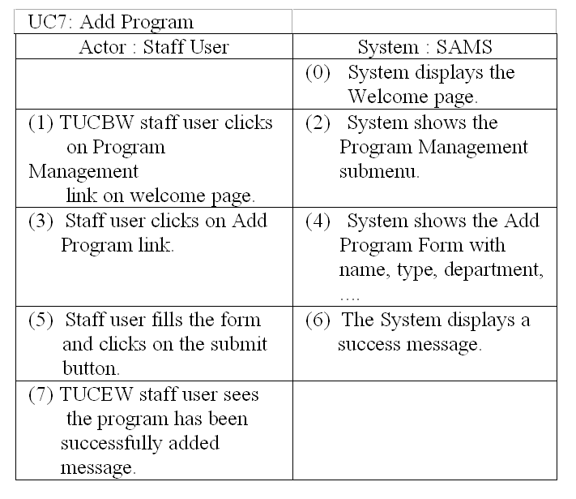
Usefulness of Domain Model
Application
student_name
term
year
language
date_applied
status
Student
*
*
apply for
1..*
Program
name
type
department
institution
subject
region
country
language
term
with
name, type, department, ...
Attributes of Program from the domain model are used to specify the input information requested.
*
manage
1..*
Staff
Part of Domain Model
8-<number>

Slide 7
Alternative Flows
Actor: User | System :Router
 | 0) T he brow ser show s any page.
1)TUCBW user enters “htp://192.168.0.1” in the address field and presses the Enter key. | 2)The system displays the Enter Network Password dialog box.
3)The user (a) enters the user name, password, optionally check the “save password” checkbox and clicks The OK button to login, or (b ) clicks the cancel button to abort. | 4)The system accordingly displays (a)The Welcome page, or (b) the Login Unauthorized page .
5)TUCEW user sees the Welcome page or the Login Unauthorized page.
8-<number>

Slide 8
Showing User Interface Prototypes
A picture is worth a thousand words.
Showing user interface prototypes with expanded use case specification is extremely useful to obtain user feedback early in the lifecycle.
These user interface prototypes may be reused in the preparation of the user’s manual, which can take place concurrently with the development effort.
8-<number>

Slide 9
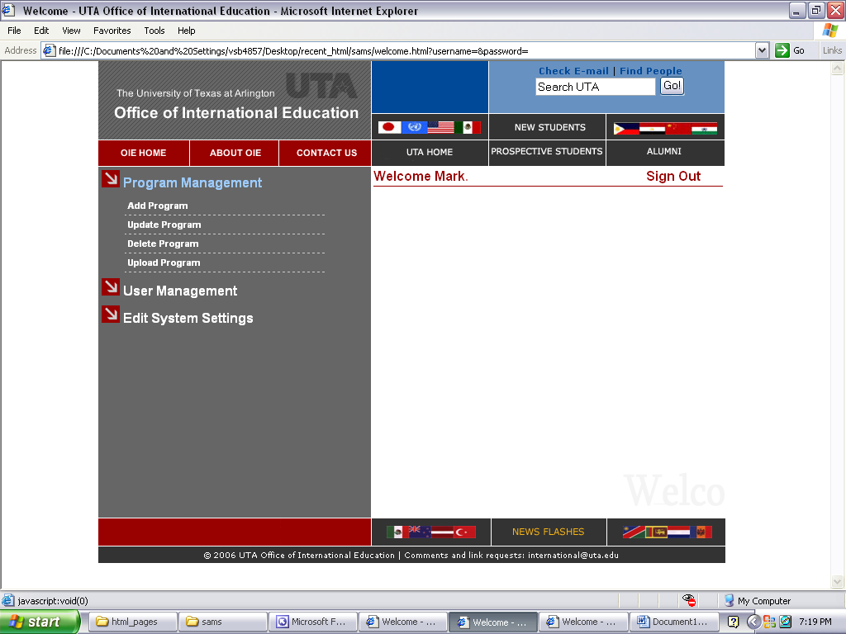
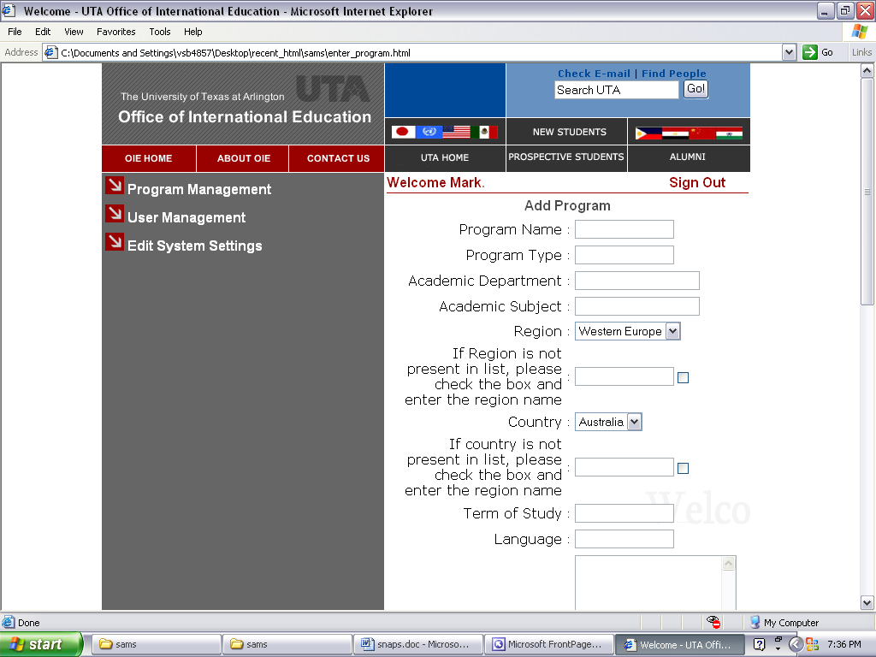
Showing UI Prototypes w/
Expanded Use Case
Actor : Staff User
System : SAMS
(1) TUCBW staff member clicks on Program Management link on welcome page.
(2) System shows the submenu consisting of various operations that a staff user can do under Program Management.
(3) Staff member clicks on Add Program link.
(4) System shows the Add Program Form
(5) User fills the form and clicks on submit button.
(6) The System updates the database with the new program details and displays a success message.
(7) TUCEW staff member is shown a message that the program has been successfully added.
8-<number>

Slide 10


Showing UI Prototypes w/Reference
Actor : Staff User
System : SAMS
(1) TUCBW staff member clicks on Program Management link on welcome page.
(2) System shows the submenu consisting of various operations that a staff user can do under Program Management.
(3) Staff member clicks on Add Program link.
(4) System shows the Add Program Form
(5) User fills the form and clicks on submit button.
(6) The System updates the database with the new program details and displays a success message.
(7) TUCEW staff member is shown a message that the program has been successfully added.
8-<number>

Slide 11
Figure 3. Submenu of staff user operations
8-<number>

Slide 12
Figure 4.
8-<number>

Slide 13
Showing Pre- and Post-Conditions
Use precondition and post-condition to specify the assumption and effect of a use case:
  Precondition: This use case assumes that the staff user has logged into the system.
  TUCBW the staff user clicks the "Add Program" button on the homepage.
  TUCEW the staff user clicks the "OK" button to acknowledge seeing the "Program successfully added" message.
  Post-condition: The added program is immediately available for search.
8-<number>

Slide 14
Expanded Use Case with Pre/Post-Conditions
Precondition: This use case assumes that the staff user has logged into the system and be shown the staff main page.
Actor: Staff User
System: SAMS
0. System displays the staff main page.
1. TUCBW the staff user clicks the
“Add Program” button.
2. System displays the Add Program
page.
3. The staff user enters program detail and clicks the ”submit" button.
4. System checks the submitted info and shows a confirmation message if no error is found.
5. TUCEW the staff user clicks the
“OK” button on the confirmation
page.
Postcondition: The added program is immediately available for search.
8-<number>

Slide 15
Guidelines for Expanded Use Case
Expanded use cases inherit all the guidelines for high level use cases (because expanded use cases are refinements of high level use cases).
Expanded use case specification should state a user interface that a novice actor can easily begin
  example: “0) System displays the homepage.”
Expanded use cases may show prototypes of the user interfaces
  for soliciting feedback from the customer/user
  to inform the programmer what the UI should look like
8-<number>

Slide 16
Guidelines for Expanded Use Case
Expanded use case specification should always end with the actor, preferably with an actor action to acknowledge that the system has accomplished the task properly.
Expanded use case specification may/should include pre- and post-conditions to explicitly specify the assumptions and effect of the use case.
8-<number>

Slide 17
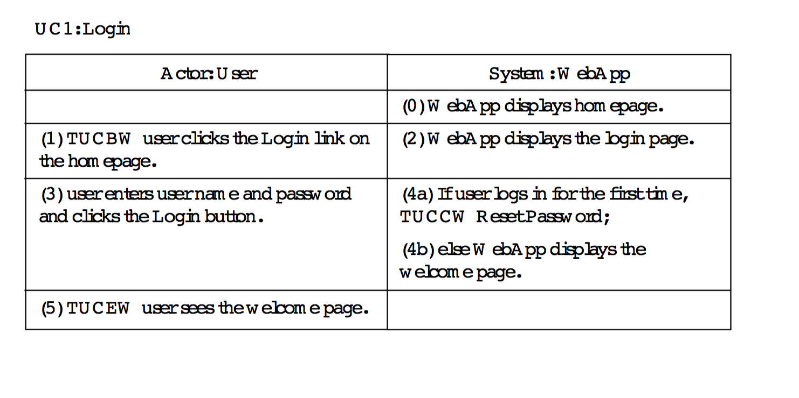
Include Other Use Cases
8-<number>

Slide 18
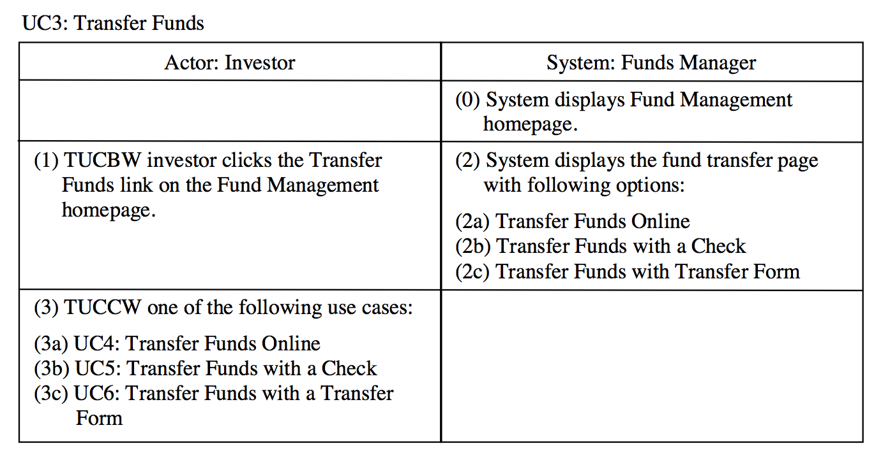
Continue With Other Use Cases
8-<number>

Slide 19
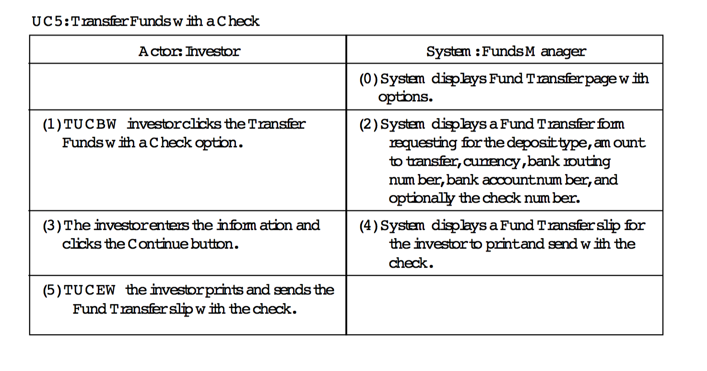
Continue With Other Use Cases
8-<number>

Slide 20
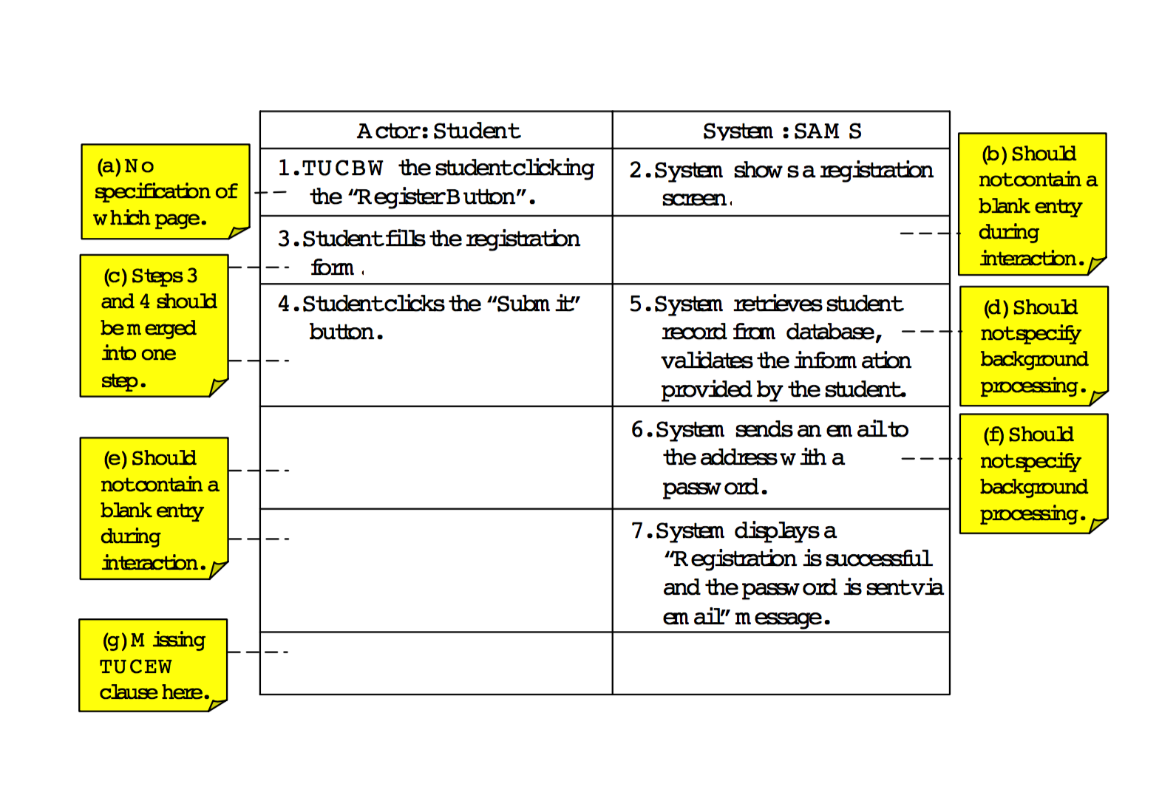
Common Mistakes
8-<number>

Slide 21
Applying Agile Principles
Keep it simple and stupid.
Avoid alternative flows.
Do not show background processing and exception handling in expanded use cases.
Good enough is enough. Quickly move on to software implementation.
8-<number>

Slide 22
Class Exercise
Work together with your teammates and write the expanded use case for a use case of your team project.
Formulate the precondition and postcondition for the expanded use case.
8-<number>

